Slide 1

Public IP

Slide 2
What is IP
An IP address is an identifier for a computer or device on a network. Every device have its unique IP address provided by the respective ISP.
IP address is randomly assigned for the device, while connecting with the particular network.
An example address might be 192.158.1.38. Each number in the set can range from 0 to 255. So, the full IP addressing range goes from 0.0.0.0 to 255.255.255.255 (Almost 4.3 Billion).
Check this system's IP

Slide 3
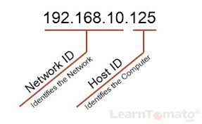
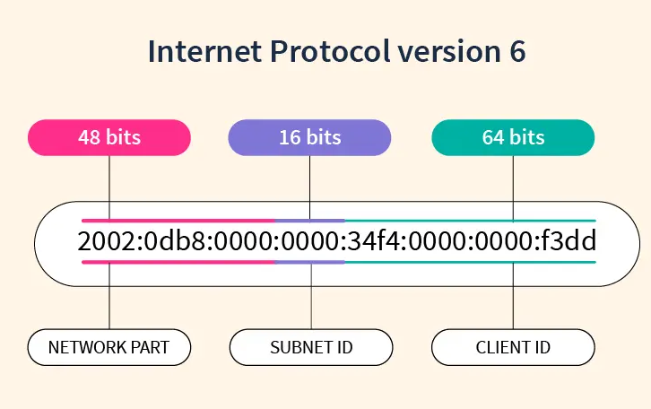
IP Versions
Internet Protocol version 4 (IPv4)
Format: 32-bit numerical labels
Ex: 192.168.0.1
Limit: 4.3 billion
Internet Protocol version 6 (IPv6)
Format: 128-bit hexadecimal numbers
Ex: 2001:0db8:85a3:0000:0000:8a2e:0370:7334
Limit: approximately 3.4x10^38 addresses

Slide 4

What is public IP?
Public IP Address: Your Network's Gateway to the Internet
Provided by the Internet Service Providers (ISP).
Unique code globally that is never reused by another device.
Public vs Private:
Public IP : Unique.
Private IP : Unique only within a network.

Slide 5
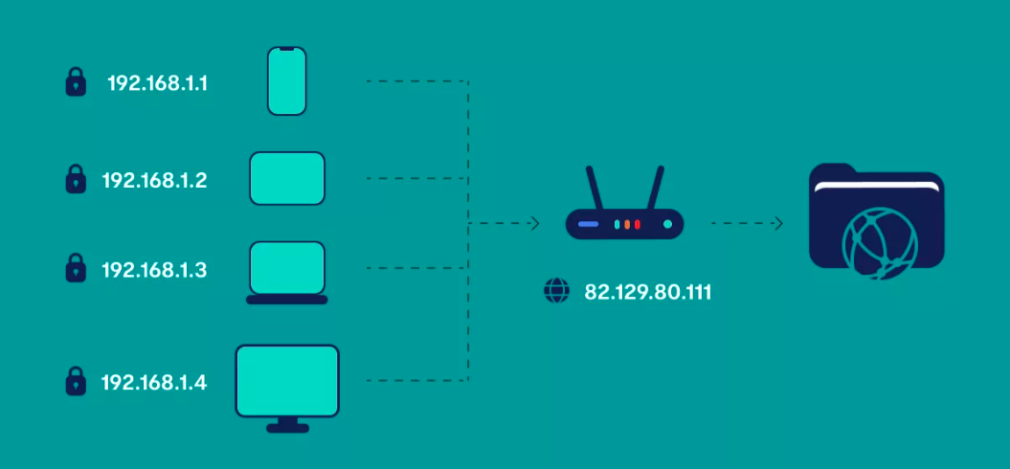

Slide 6
Static IP Address
Static IP address is a permanent IP address that does not change.
If you have a web server that must have an address that cannot change, you can get a static IP address from your ISP.

Slide 7
Dynamic IP Address
Dynamic IP address can change every time a user reboots their router or system, and when the user connects to their ISP service.
A dynamic IP address is typically assigned by your ISP using a protocol called Dynamic Host Configuration Protocol (DHCP).

Slide 8
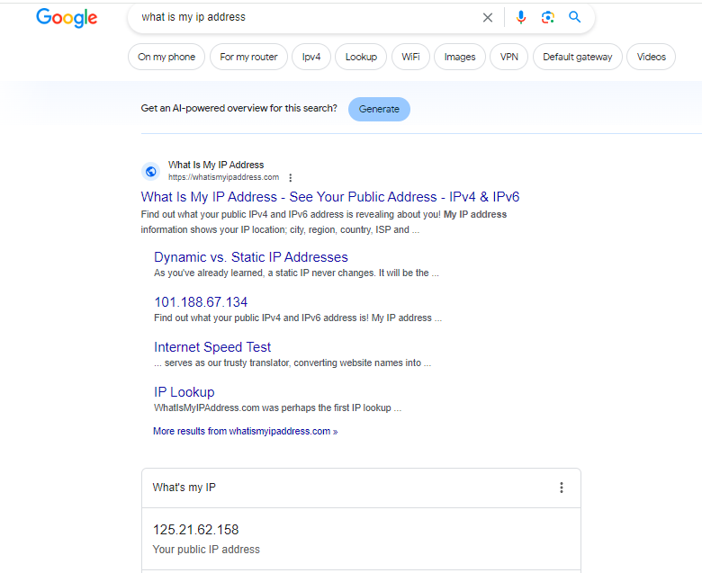
Find Our Public IP
Go to a google website.
In the search bar, type "What is my IP address" and press Enter.

Slide 9
ADVANTAGES
Global Accessibility
Hosting Services
Direct Communication
Remote Access

Slide 10
DISADVANTAGES
Security Concerns
Limited Availability
Cost
Complexity

Slide 11
APPLICATION
Web Hosting
Email Servers
Online Gaming
VoIP (Voice over Internet Protocol)
Server Farms and Data Centers
Internet of Things (IoT) Devices
E-commerce Transactions

Slide 12
Thank you

